Slide 1
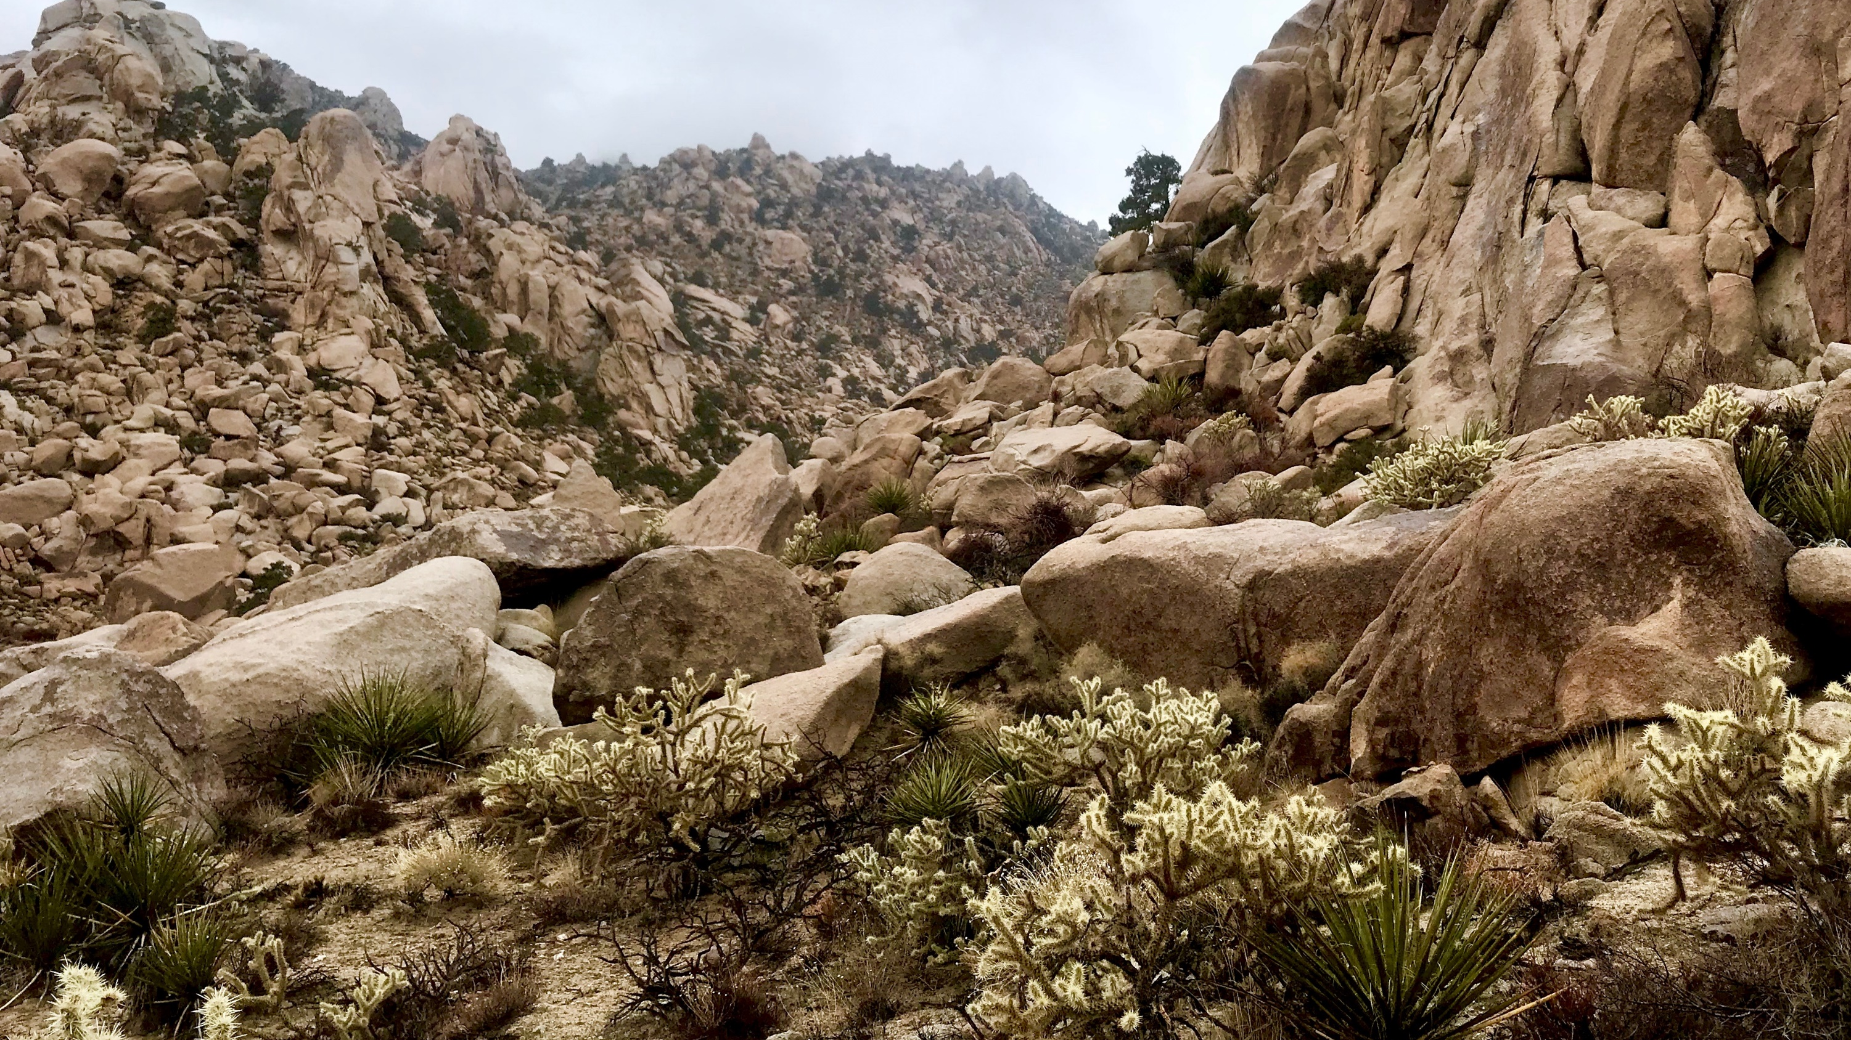
Pollination and Seed Dispersal of Cactaceae by Avian Interactors
Malory Owen & Christopher Lortie
Spring 2019 Progress Report

Slide 2
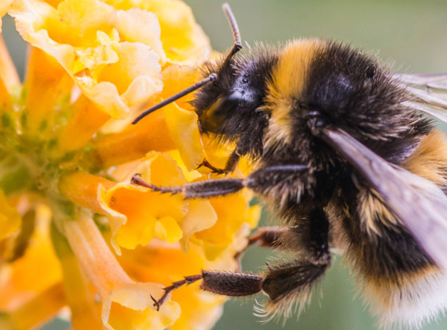
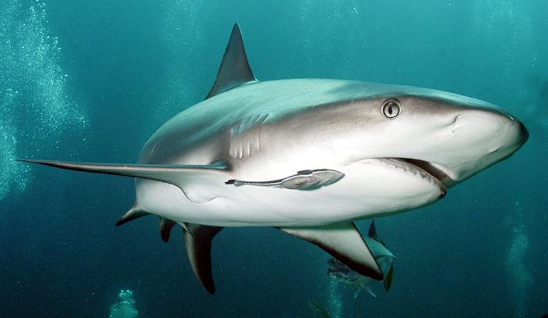
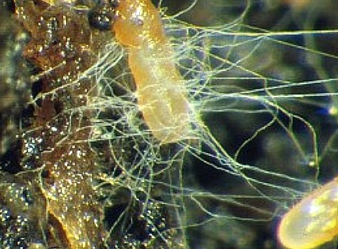
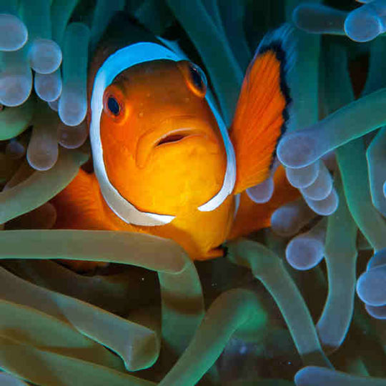
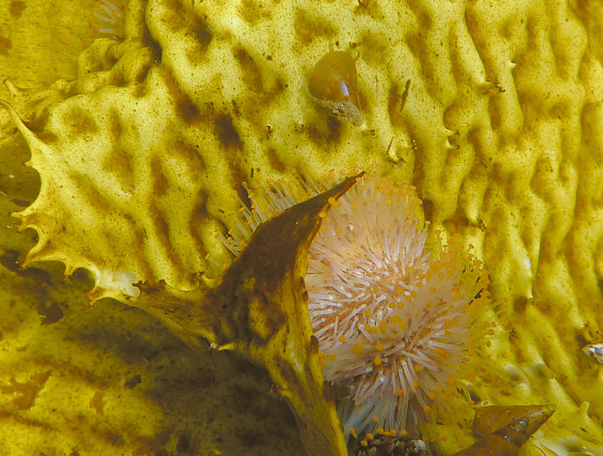
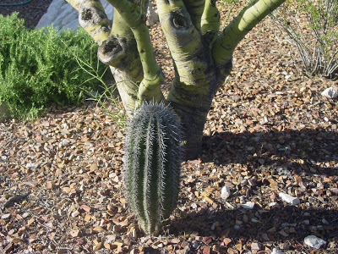
Shark and remora, shrub and cactus, clownfish and anemone,, mycorrhizae, bee and flower, kelp, gastropod, and sea urchin
Notes:
Any association between two or more individuals where at least one individual has a benefit to its health, fitness, or survivability and neither is negatively impacted (although, adjacent competition may occur alongside positive interactions).
Positive interactions take many forms.
Pathways

Slide 3
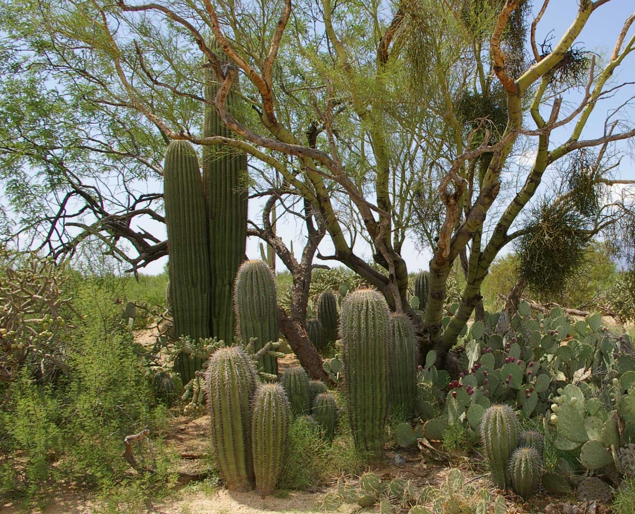
Facilitation: change your environment, change your life!
plant

Slide 4
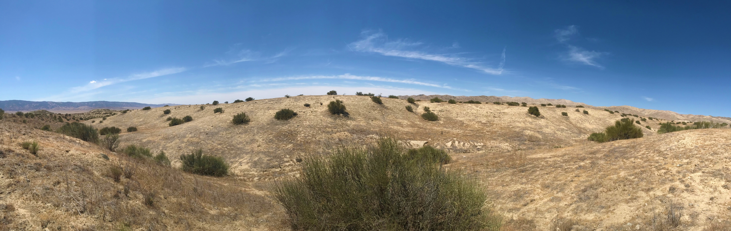
Foundational Species
Notes:
When a species facilitates many other species in an ecosystem and becomes a dominant species, it’s known as a foundational species. Shrub species documented as the most common benefactor plant species globally (above is Ephedra californica).

Slide 5
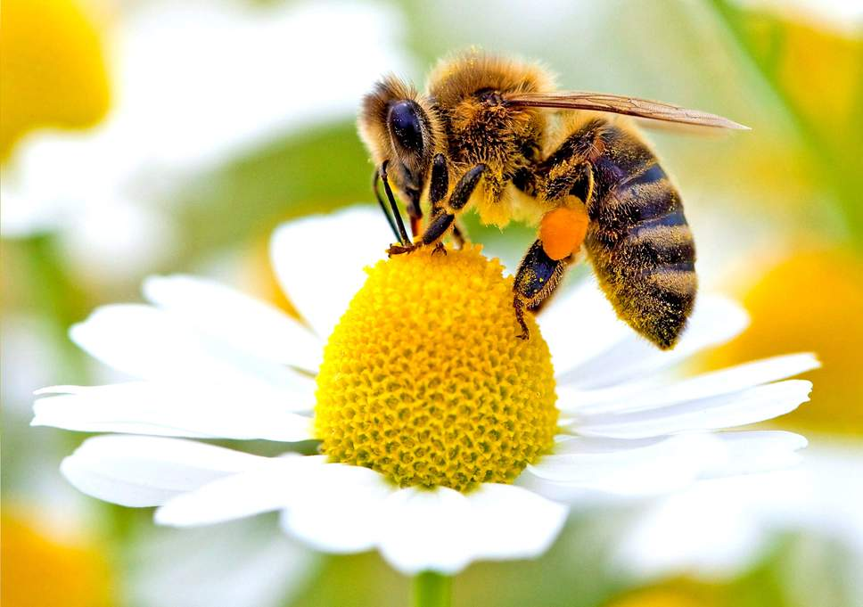
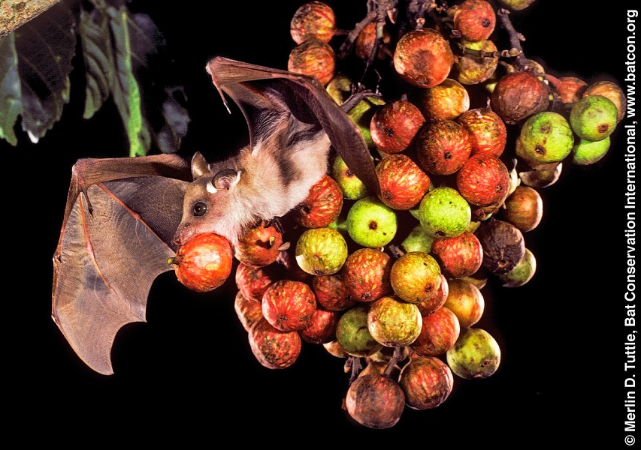
Mutualism
Bat, bee
Notes:
Single mutualism: when an interaction is positive for both interacting species.
Ex: bee pollinating flower, fruit bat eating fruit and dispersing seeds

Slide 6

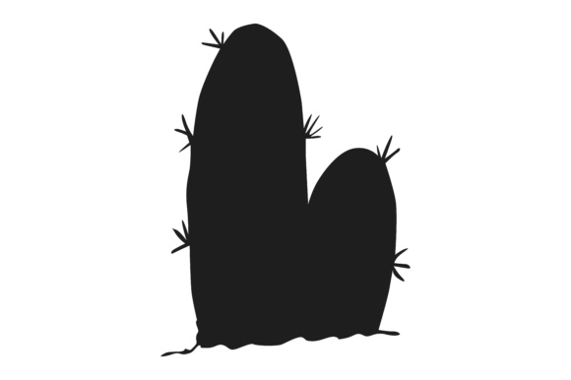
pollination
seed dispersal
same interacting species
Double Mutualism
Notes:
Double mutualism;
When one species, in same habitat, performs dual services: ex, pollination and seed dispersal
Most common in “harsh” climates: islands/deserts.
Cacti, being foundational ssp in deserts, may be utilizaing double mutualism…

Slide 7
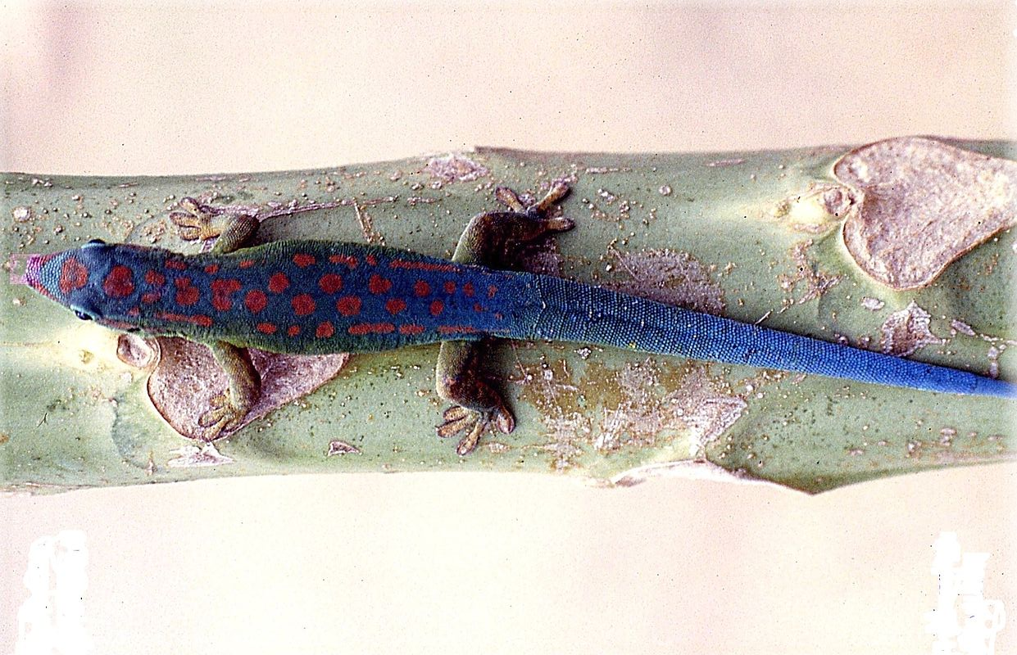
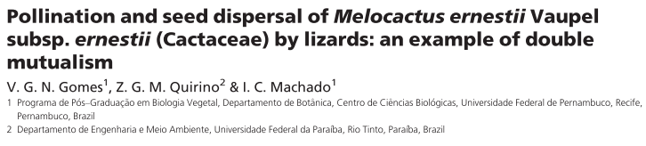
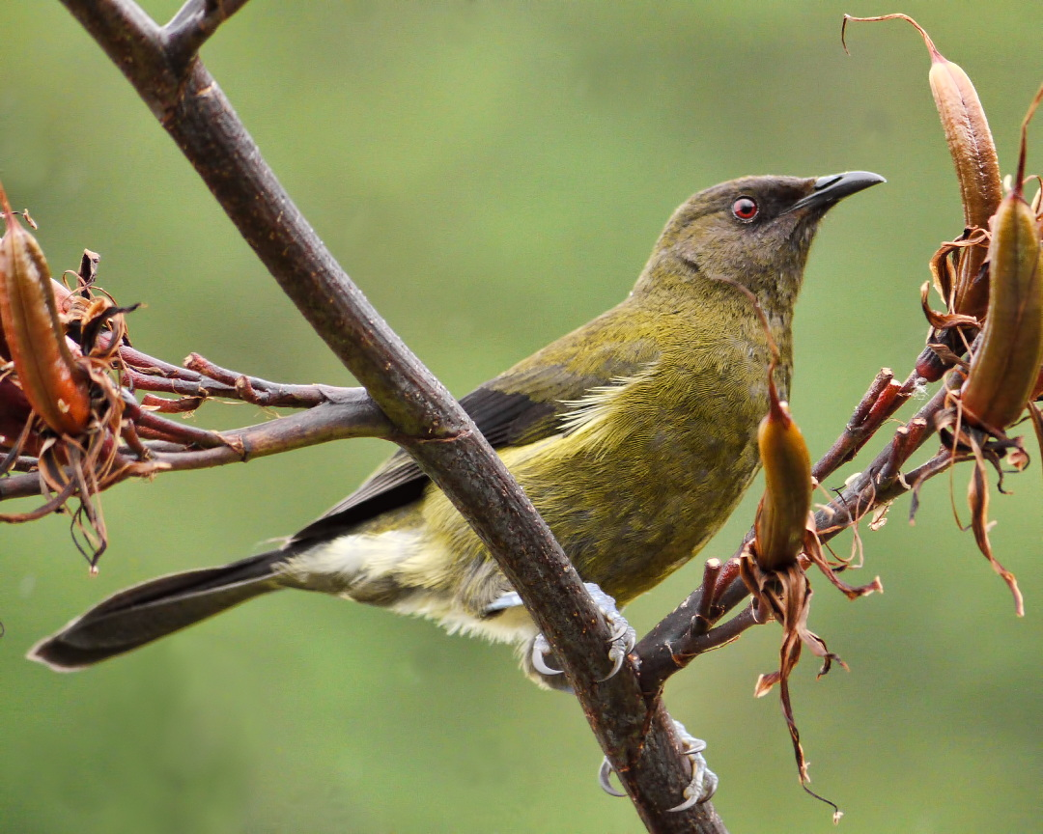
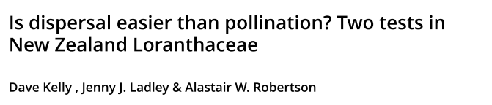
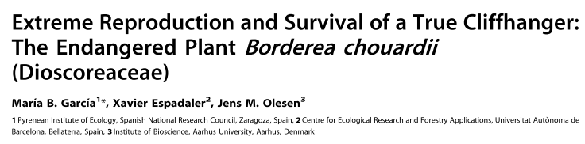
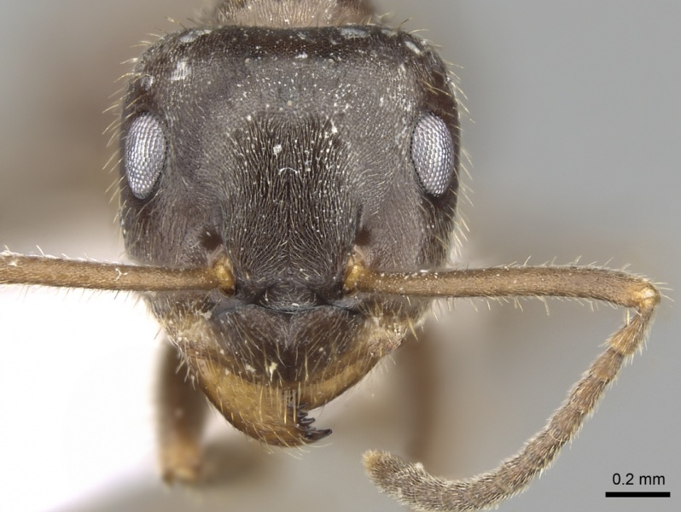
Phelsuma cepediana
Anthornis melanura
Lasius grandis

Slide 8






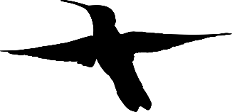
Notes:
So what is an advantageous adaption for cactus? Showier displays (more flowers/fruits) attract more pollinators/seed dispersers. Higher inflorescenses attract more pollinators/seed dispersers (flying individuals).
According to optimal foraging theory, foragers in patchy ecosystems function under marginal value theory where they will forage in one spot until the resource availability at that spot is equal to/lower than the entire habitat’s resource availability (then they will move on). This value is known as Giving Up Density (GUD). This leads us to believe cacti will produce many flowers/fruits, and be very tall. However, this isn’t the whole picture…

Slide 9
Benefits of seed dispersal
Colonization of remote areas
Increased germination
Escape from predation
Notes:
Seed dispersal benefits plants in that is allows for seeds to physically get to new locations, improves germination rates after passing through the gut of an animal, and helps escape predation that may be existing on a mother plant. However, this isn’t the whole picture…

Slide 10


Notes:
Tradeoffs. Finite amount of money, have to allocation funds to rent and food, but you might have to make compromises (close to subway, hard wood floors, big windows, safe neighborhood versus fresh fruits/veggies, lots of food, name brand). Plants also make these tradeoffs with their energy.

Slide 11
Notes:
Cacti must make these tradeoffs as well, between non-reproductive structures and reproductive structures. This translates to height and flowers/fruits, two factors that influence nectarivore and frugivore interactions.

Slide 12

Intermediate flower production
Intermediate Height
Plants must make tradeoffs to maximize two mutually exclusive structures
Notes:
We believe plants will make these tradeoffs to maximize pollinator/seed disperser interactions.
Defining intermediate height as middle of equal binning of height since the distribution had no distinct breaks.
Defining intermediate flower/fruit production as 1 standard deviation from the mean flower/fruit production.

Slide 13




Slide 14
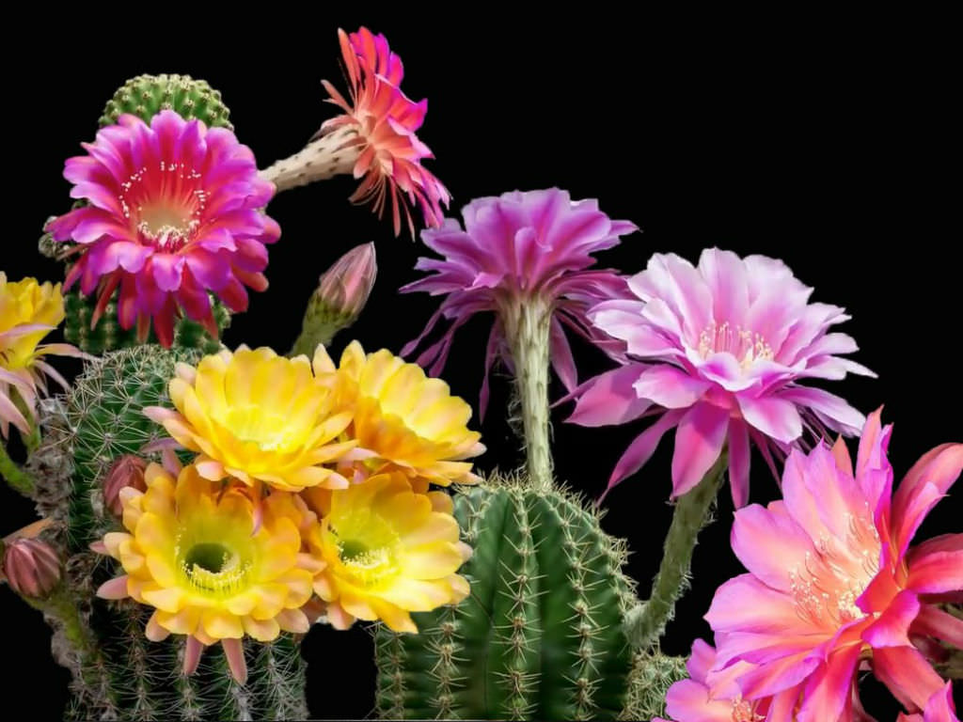
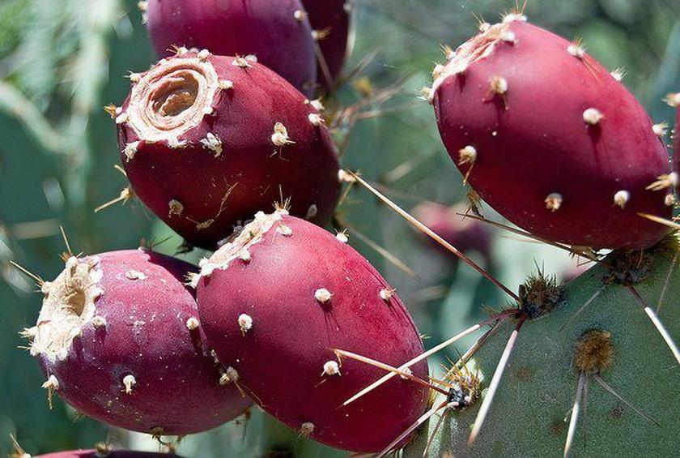
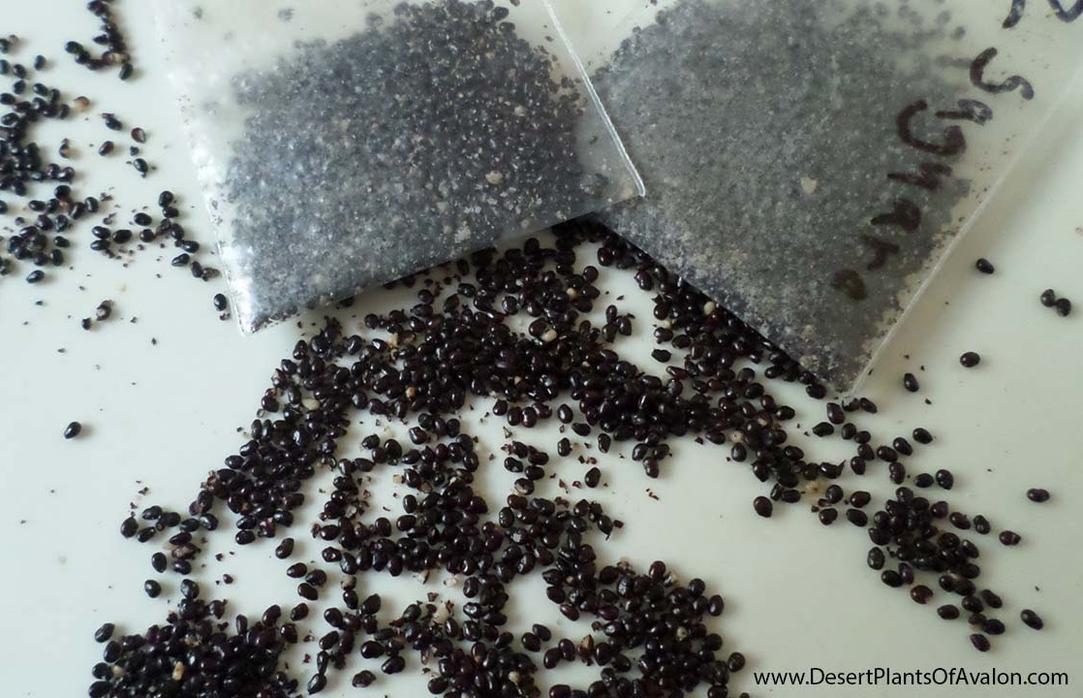
Chapter 1: A meta-analysis of allocation in Cactaceae reproductive structures
Purpose: Quantitatively examine the relationship between three different reproductive outputs of Cactaceae (flowers, fruits, and seeds).
?
?
Flower, fruit, seed
Notes:
Give audience a moment to read slides. TLDR: Is allocation theory justified in Cactaceae?

Slide 15
Research Questions
Are reproductive outputs in Cactaceae (flowers, fruits, and seeds) correlated?
How does Cactaceae phylogenetic distance related to reproductive output?
Where are Cactaceae reproductive studies relative to native and nonnative Cactaceae locations?
What research gaps exist in Cactaceae allocation research, and what opportunities for agro-eco interdisciplinary work have been unexplored?

Slide 16
Methods
Search | Terms | Hits | Refines
1 | cact* and allocat* | 25 | topic, last five years
2 | cact* and fruit* and size | 63 | topic, last five years
3 | cact* and seed and fruit* | 110 | topic, last five years, articles
4 | cact* and seed and size | 53 | topic, last five years
5 | fruit* and seed and size and allocat* | 69 | topic, last five years
6 | cact* and size and allocat* | 10 | topic, last five years
7 | cact* and fruit and agricultur* | 18 | topic, last five years
8 | cact* and flower* | 127 | topic, last five years
9 | cact* and flower* and agricultur* | 5 | topic, last five years
 | total | 424
Completed:
Systematic Review
Web of Science
Future:
Older papers
TRY Plant Traits database
Analyze in R package “metafor”

Slide 17
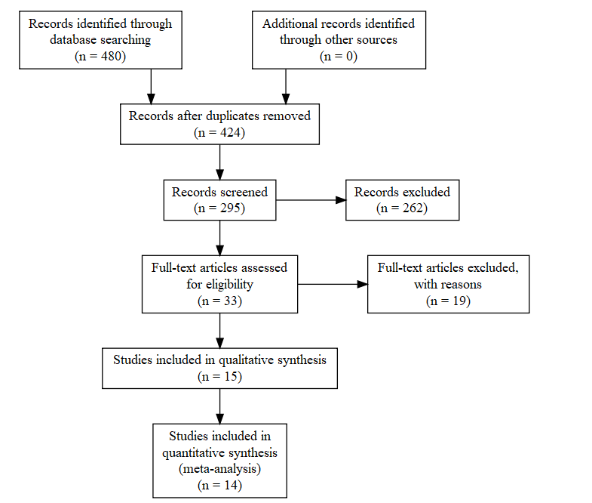

Slide 18
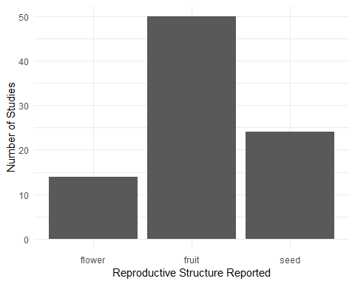
Preliminary Results
50
40
30
Number of Studies
20
10
0
flower
fruit
seed
Reproductive Structure Reported
Notes:
Fruit is the most frequently reported reproductive structure, but I believe adding “Flower” to search terms will drastically increase the number of reported flowers

Slide 19
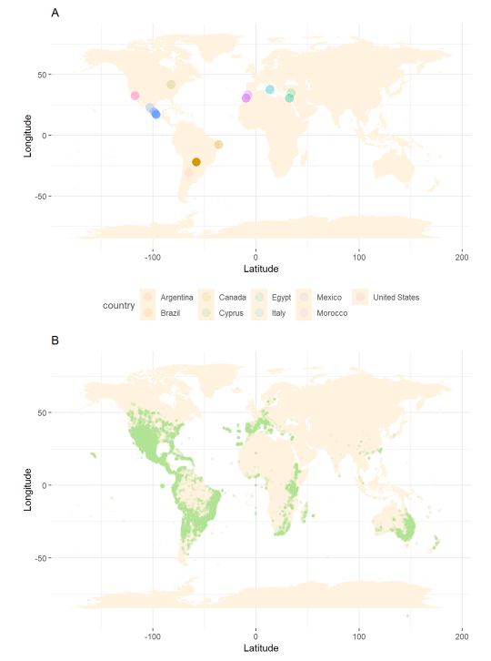
Preliminary Results
Notes:
Cacti are native to western hemisphere (except for one species in Africa), but introductions have created invasive species, and agricultural products have made the family present globally.

Slide 20
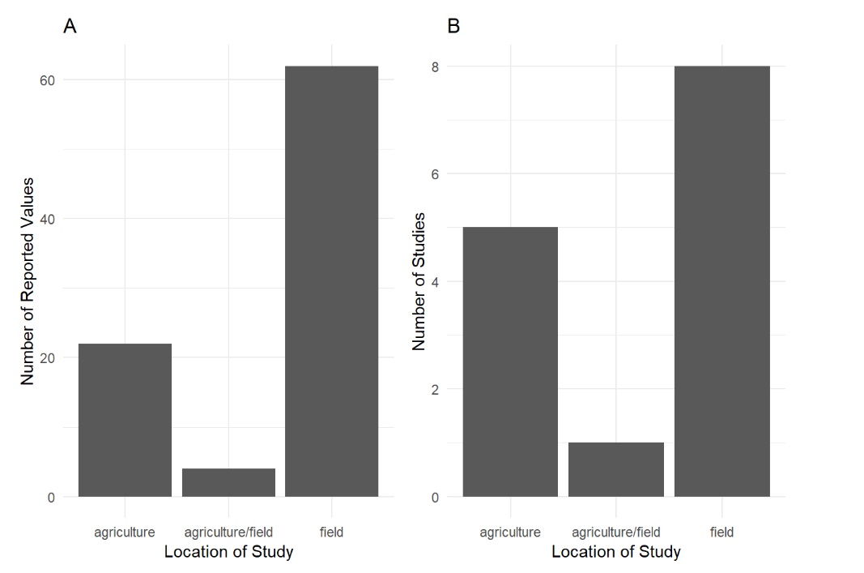
Preliminary Results
A
B
60
8
6
40
Number of Reported Values
Number of Studies
4
20
2
0
0
Agriculture Agriculture/field Field
Agriculture Agriculture/field Field
Location of Study
Notes:
Most studies are relevant to agricultural and ecological sciences, but there is little overlap in subdisciplines. From the systematic review, methodology differs significantly between disciplines. With this part of my project, I’d like to work towards bridging the gap between these two fields.

Slide 21
Chapter 2: Linking Avian Double Mutualistic Interactions to Cactaceae Seed Dispersal and Facilitation
Purpose: The aim of this study is to determine the frequency of this double mutualistic, facilitation-inducing interaction between birds and a foundational species of cactus based on morphological characteristics of cactus individuals.
Notes:
Give audience a moment to read the slides. TLDR: Describe the interaction between birds and C. acanthocarpa.

Slide 22
Research Questions
Are different reproductive structures of cacti correlated with one another or with Cylindropuntia acanthocarpa estimated plant volumes?
What avian communities are double mutualistically associated with C. acanthocarpa and how frequent are Avian-C. acanthocarpa double mutualistic interactions?

Slide 23
Hypotheses
Cacti compromise on allocation to reproductive and non-reproductive structures. Relative attractiveness of a cactus influences frequency of single and double mutualistic interactions with nectarivorous and/or frugivorous birds.
Notes:
Trying to determine: Why, Who, and How.

Slide 24
Predictions
Predictions:
Flower and fruit production will be positively correlated, but cactus height/volume and reproductive output will be negatively correlated.
Bird visitation rates are dependent on cactus morphological characteristics, with intermediately sized cacti with intermediate reproductive output (intermediate being defined as 1 standard deviation from the mean) drawing the most avian nectarivores and frugivores.
Cacti with the more bird visitation will have more occurrences of double mutualistic interactions.
Notes:
Let audience read slide

Slide 25
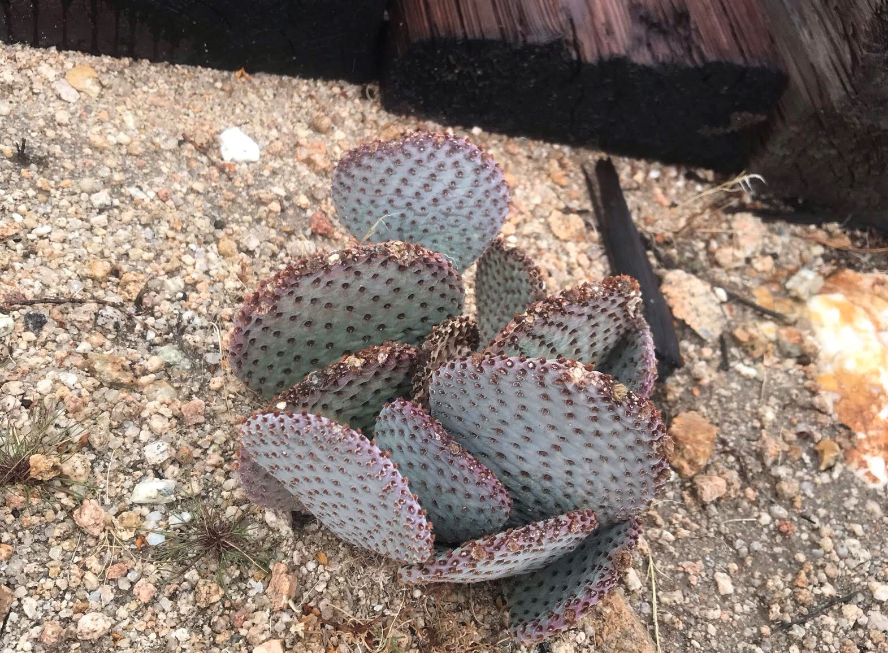
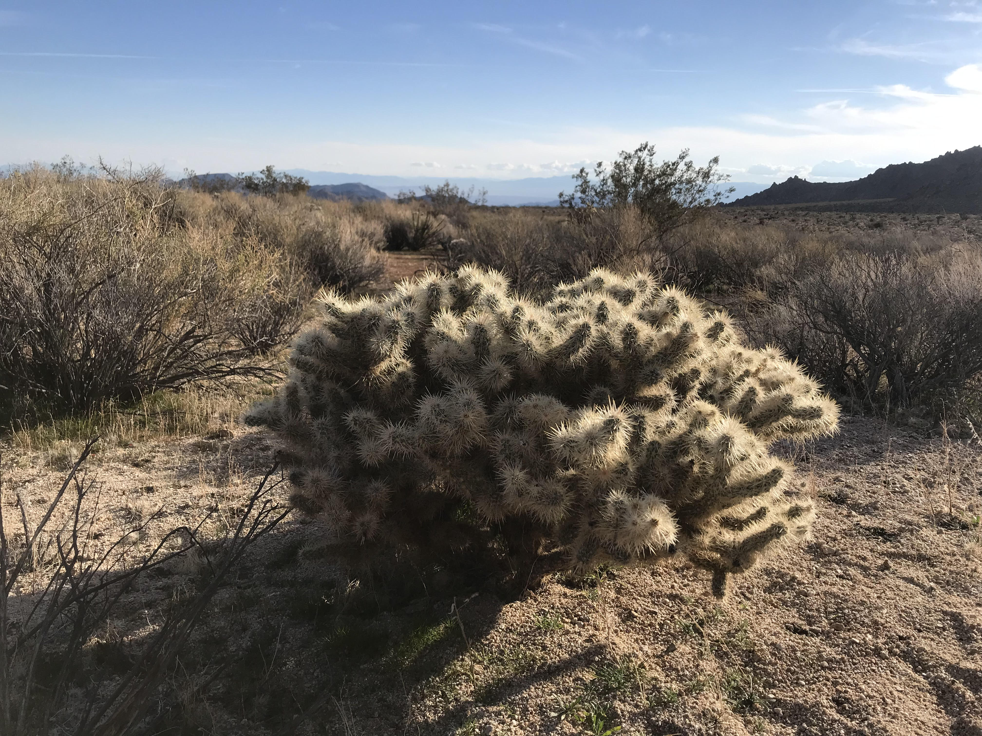
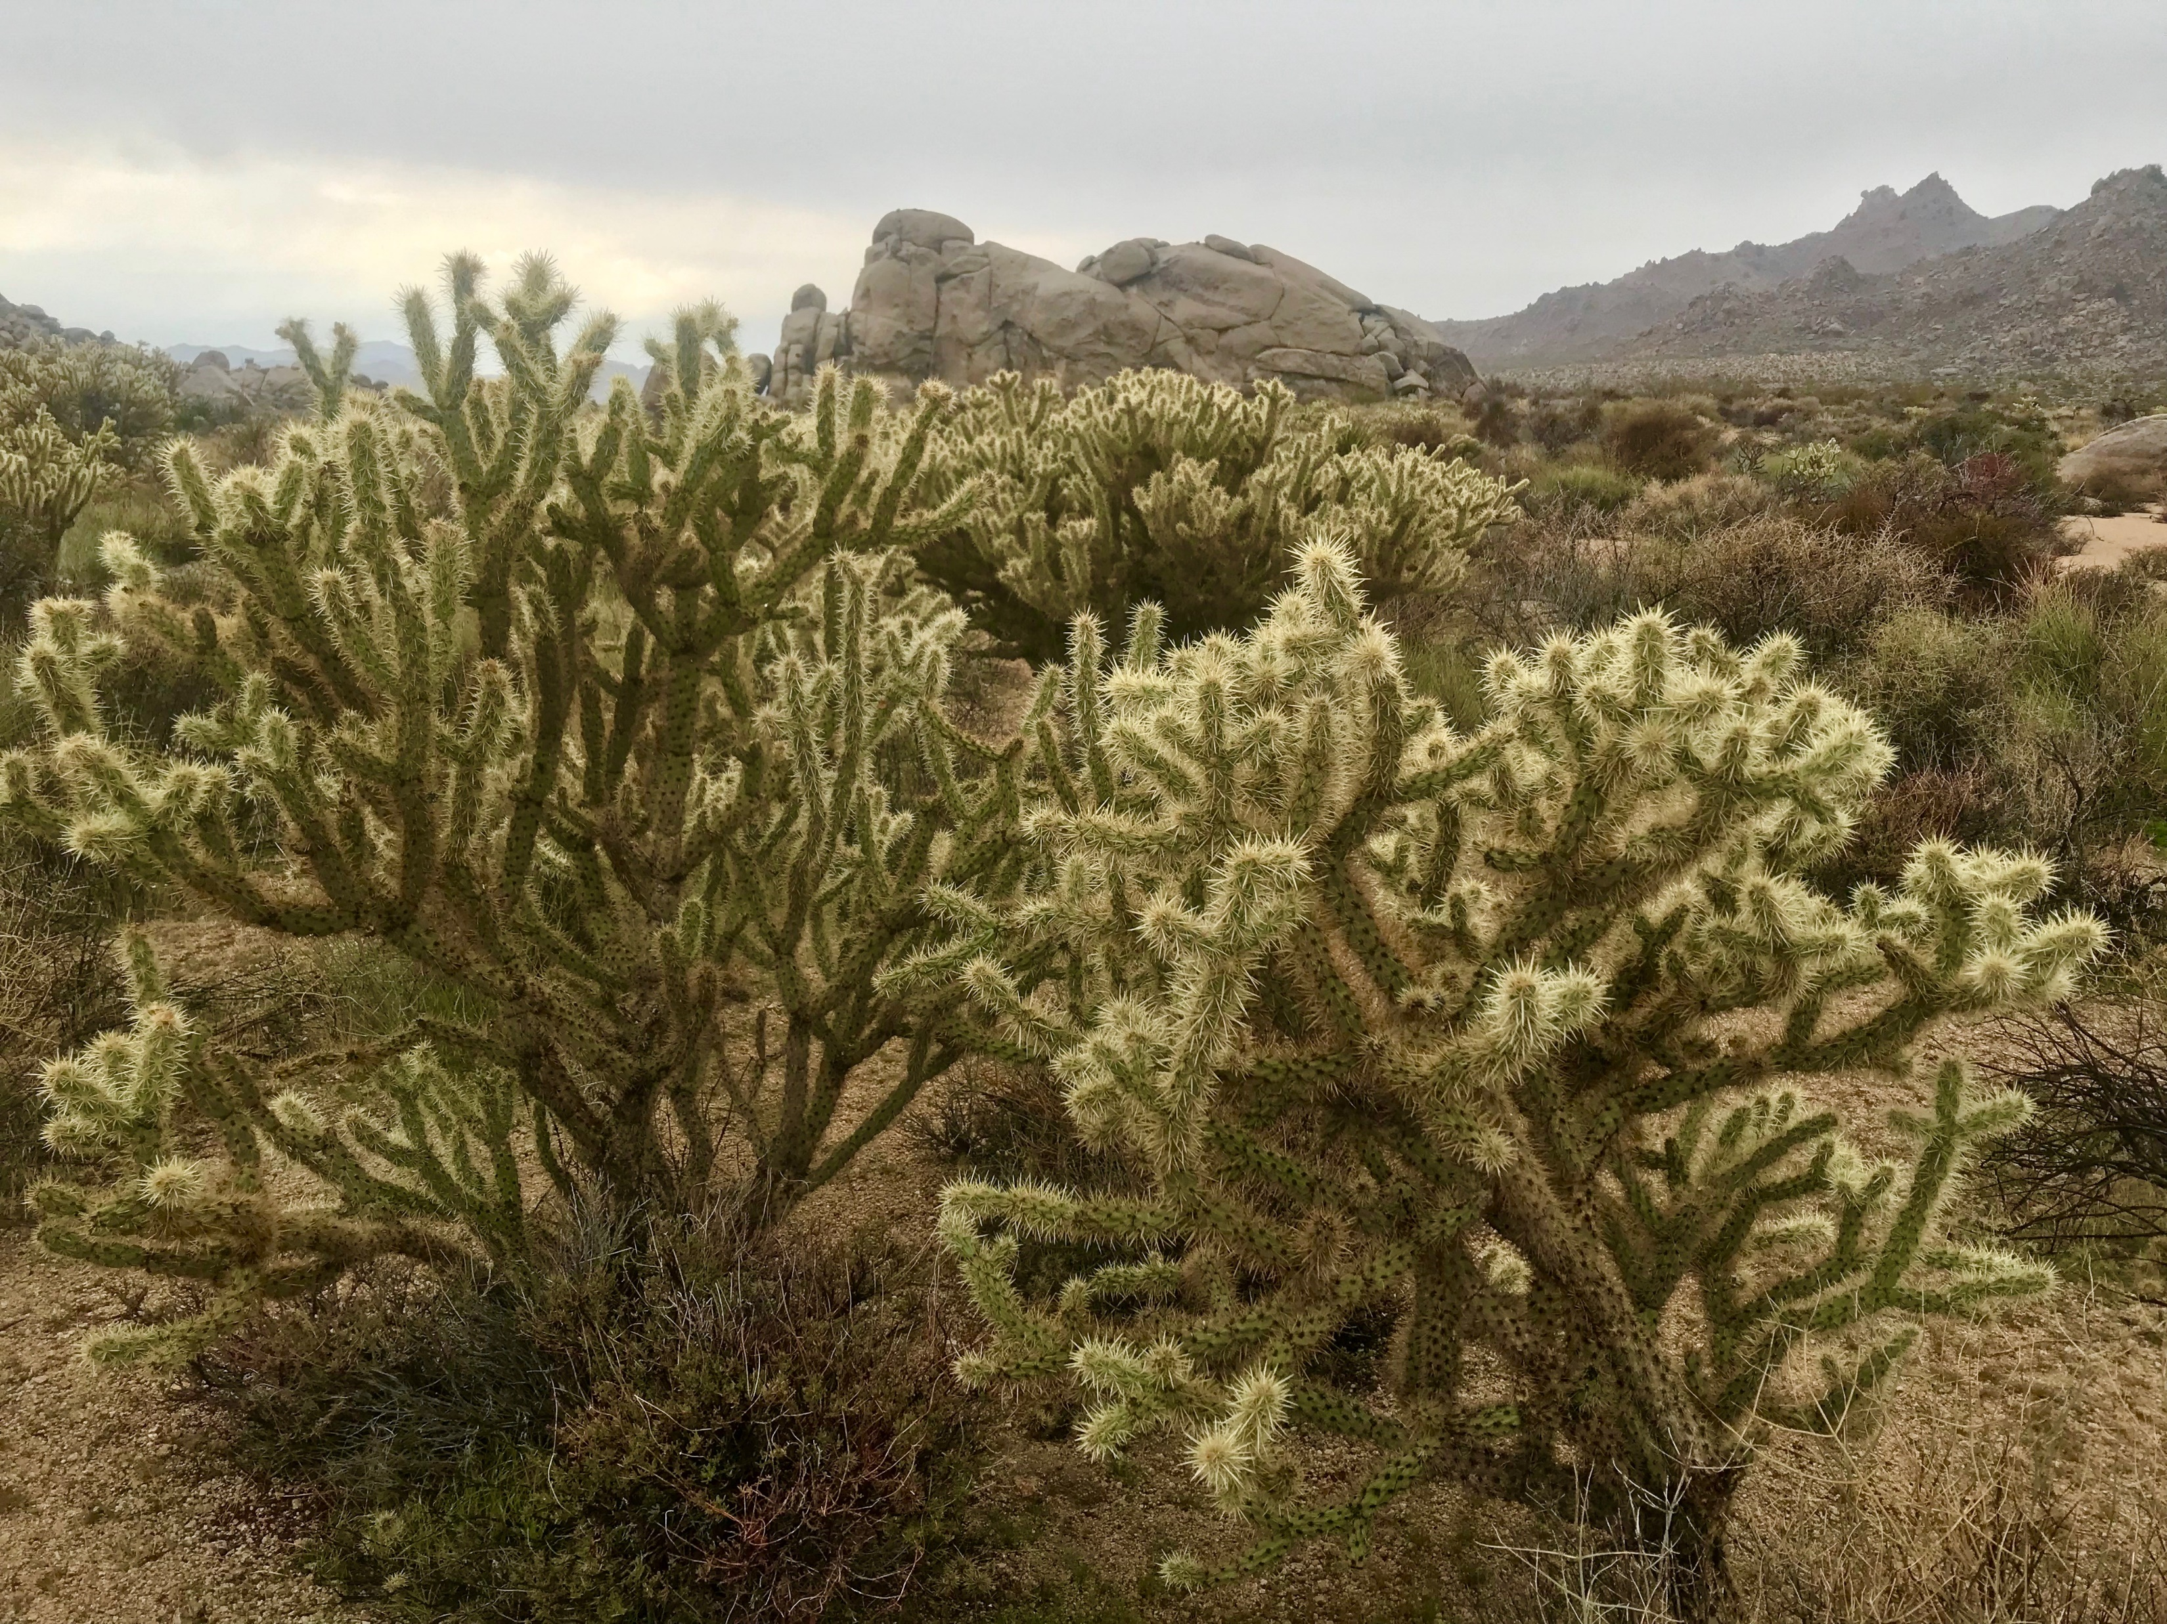
Methods: Preliminary Cactus Survey
Cylindropuntia acanthocarpa, Cylindropuntia echinocarpa, & Opuntia basilaris
Transects or haphazard
Major, minor, and vertical axes measured
Health index (1-5)
Branch death, rot, and scarification

Slide 26
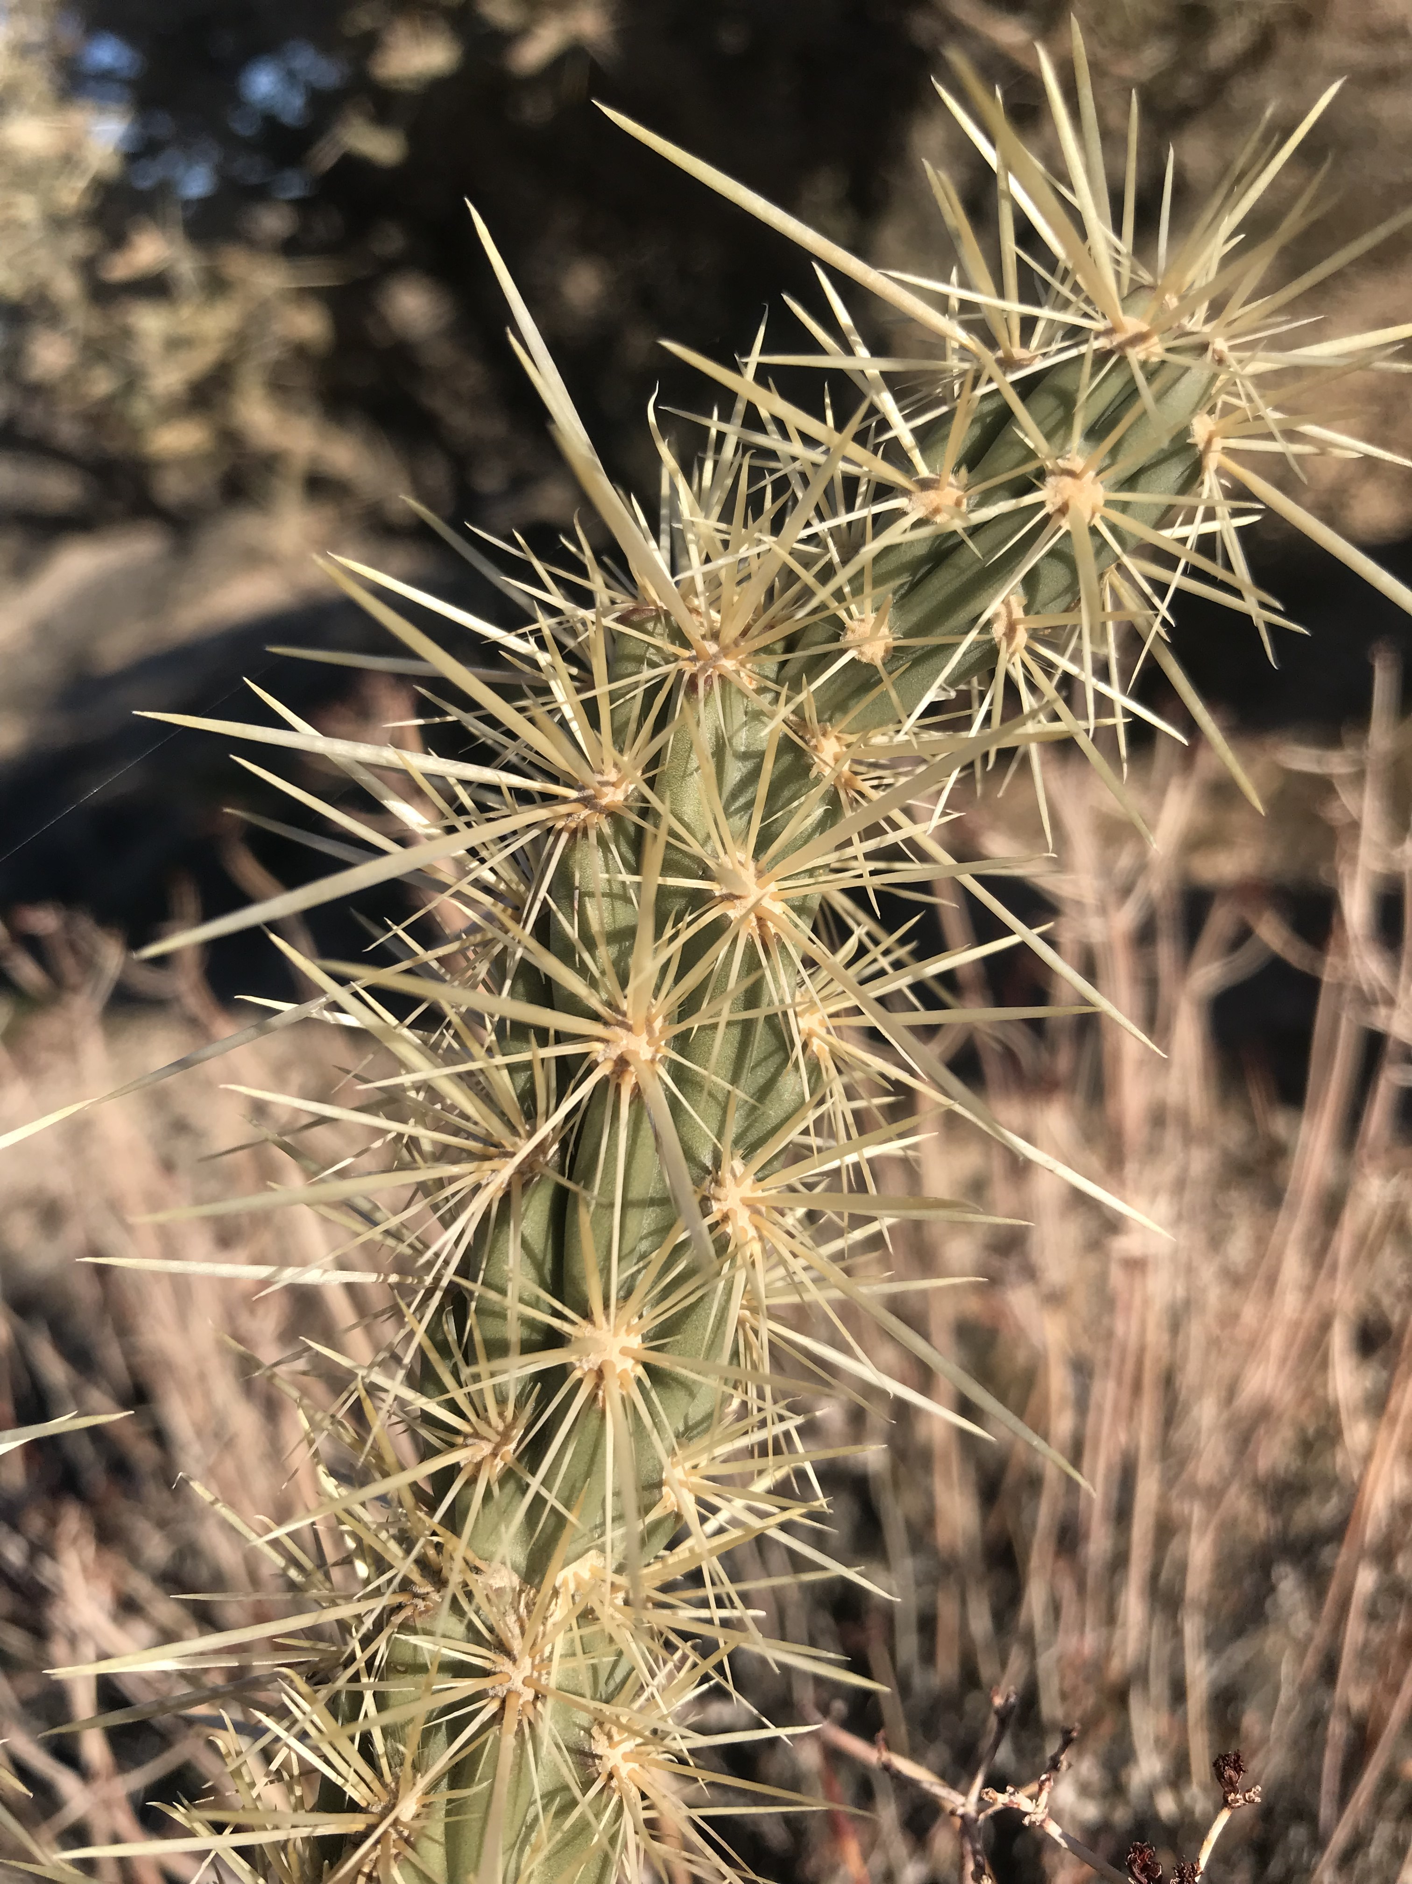
Methods: Experimental Manipulations
Cylindropuntia acanthocarpa
Small, medium, large class sizes
0%, 25%, 50%, 75%, 100% flowers or fruits removed
7 replicates (105 total cacti, 3.5 hours per day)
1 hour focal observations

Slide 27
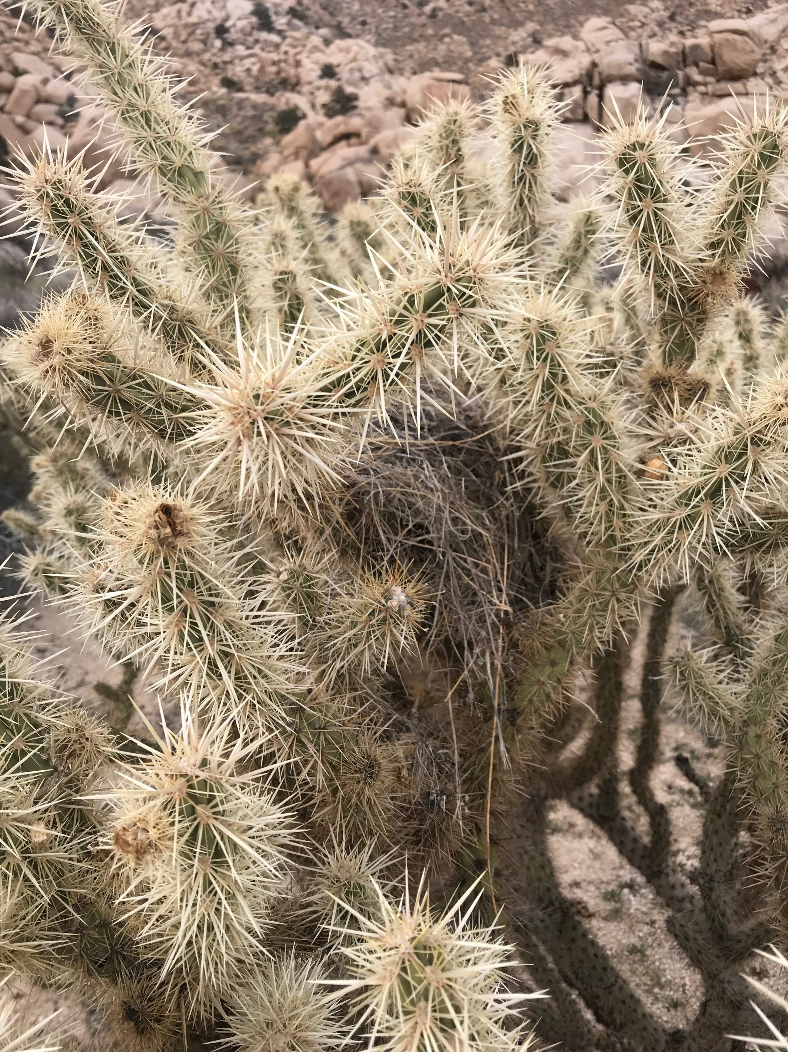
Methods: Experimental Manipulations
Ethogram
Species/behavior identification aided by 150-600mm digital camera
Measure sucrose content in flowers
Weigh fresh fruit and seeds

Slide 28
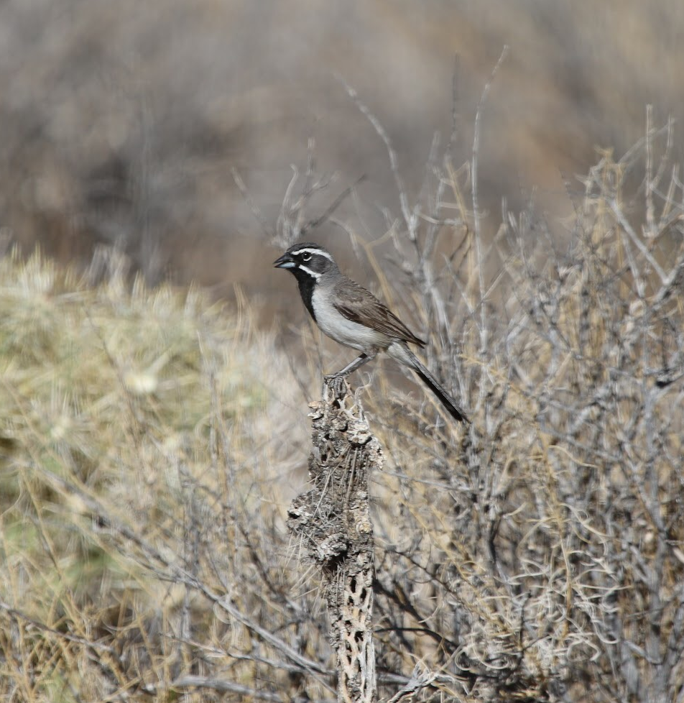
Methods: Joy Sampling
Area search
50 hours total (2 hour sessions)
Mesohabitat/behavior
Geotag
Point count
50 hours total (2 hour sessions)
Monitor one cactus
Notes:
The purpose of joy sampling is to serve as a baseline for what avian diversity looks like a the site level. We are hoping to do a full site geotagged survey of shrubs and cacti at the site, which will provide an great look at overlapping bird geolocations, and potential interactions. (Where are birds spending their time?)
Question: should I only monitor cacti for point count, or split into different mesohabitats? (open, shrub)

Slide 29
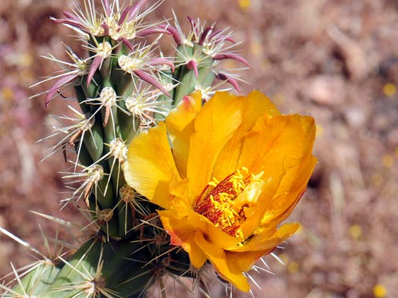
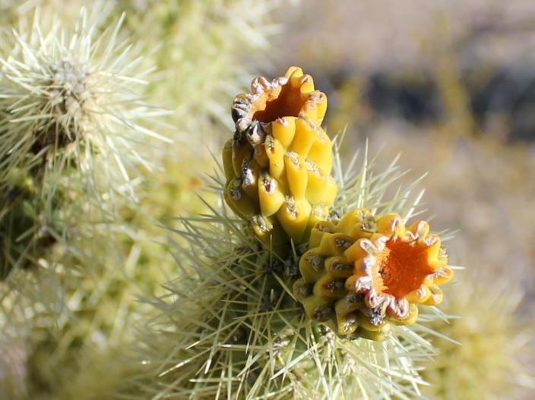
Paired Observations
20 cactus individuals
Geotag
Count flowers in May, fruit in August
Flower, fruit
Notes:
Monitor to determine link between flowers and fruit (same indivdiuals)

Slide 30
Preliminary Results
Which cactus species is most appropriate to study?
Can we measure how different species of cacti fulfill unique niches with morphological surveys?

Slide 31
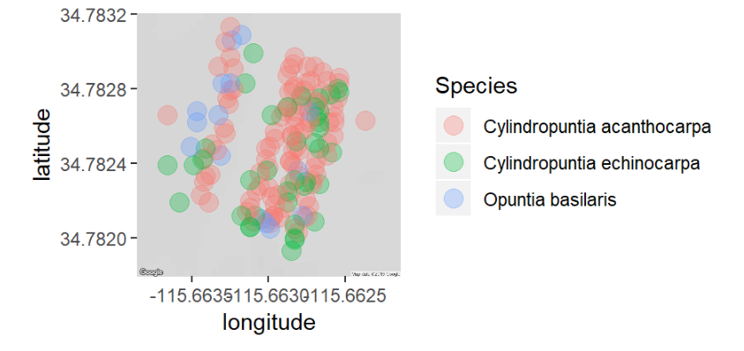
Preliminary Results: Location
Notes:
C. Acanthocarpa was most dense, and we see geographic overlapping of cacti, suggesting they do not exhibit niche overlap

Slide 32
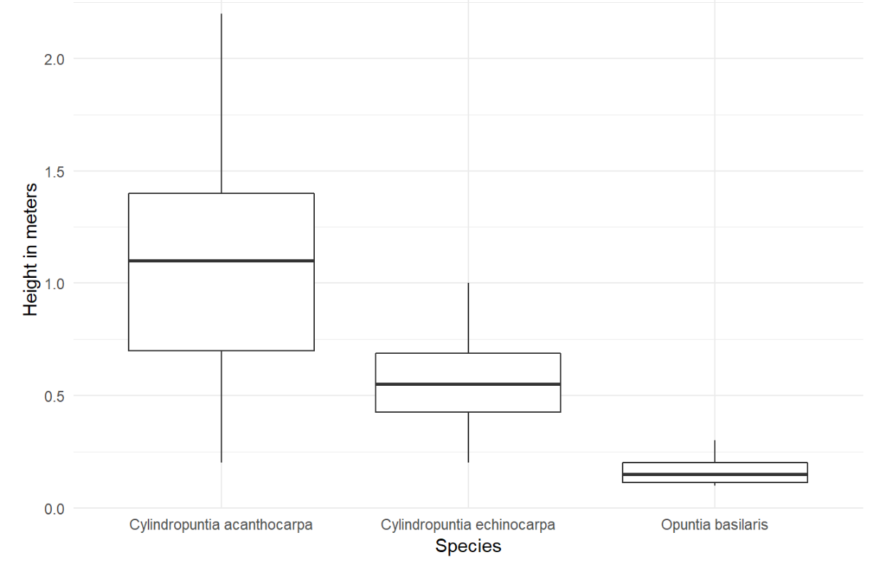
Preliminary Results: Size
Kruskal-Wallis, Chi-square = 3.71, p > 0.0001, df = 52
Means heights of 1.04 meters for C. acanthocarpa, 0.55 meters for C. echinocarpa, and 0.17 meters for O. basilaris
0.0 0.5 1.0 1.5 2.0
Height in meters
Cylindropuntia acanthocarpa
Cylindropuntia echinocarpa
Opuntia basilaris
Notes:
C. Acanthocarpa was largest. Remember, pollinators prefer higher inflorescences, so likely different pollinators.

Slide 33
Preliminary Results: Size Class
Species | Small | Medium | Large
Cylindropuntia acanthocarpa | <85cm | 86cm - 152cm | >153cm
Cylindropuntia echinocarpa | <45cm | 46cm - 72cm | >73cm
Opuntia basilaris | <15cm | 16cm - 22cm | >23cm
Notes:
C. Acanthocarpa had the widest size classes. This is important bc it may more clearly translate to how birds are viewing differences in size

Slide 34
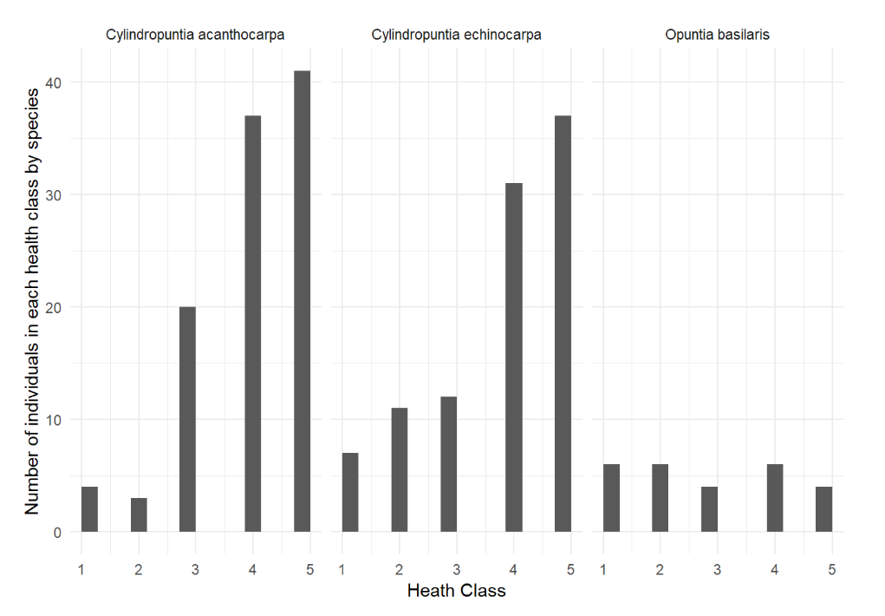
Preliminary Results: Health
Cylindropuntia acanthocarpa
Cylindropuntia echinocarpa
Opuntia basilaris
Pearson’s Chi-squared Test, X-squared = 27.325, df = 8, p > 0.001
Number of individuals in each health class
0 10 20 30 40
 | 1 | 2 | 3 | 4 | 5
C. acanthocarpa | 4 | 3 | 20 | 37 | 41
C. echinocarpa | 7 | 11 | 12 | 31 | 37
O. basilaris | 6 | 6 | 4 | 6 | 4
1 2 3 4 5 1 2 3 4 5 1 2 3 4 5
Health Class
Notes:
Health likely determines reproductive output, which is important for nectarivores and frugivores. Cacti are highly clonal, we may expect to see less emphasis on health (and therefore reproductive output) for clonal species. So those which are more able to resist scarification and rot will have more output, and therefore more bird interactions. Which is a different niche than one which has no bird interactions and primarily reproduces by cloning.

Slide 35
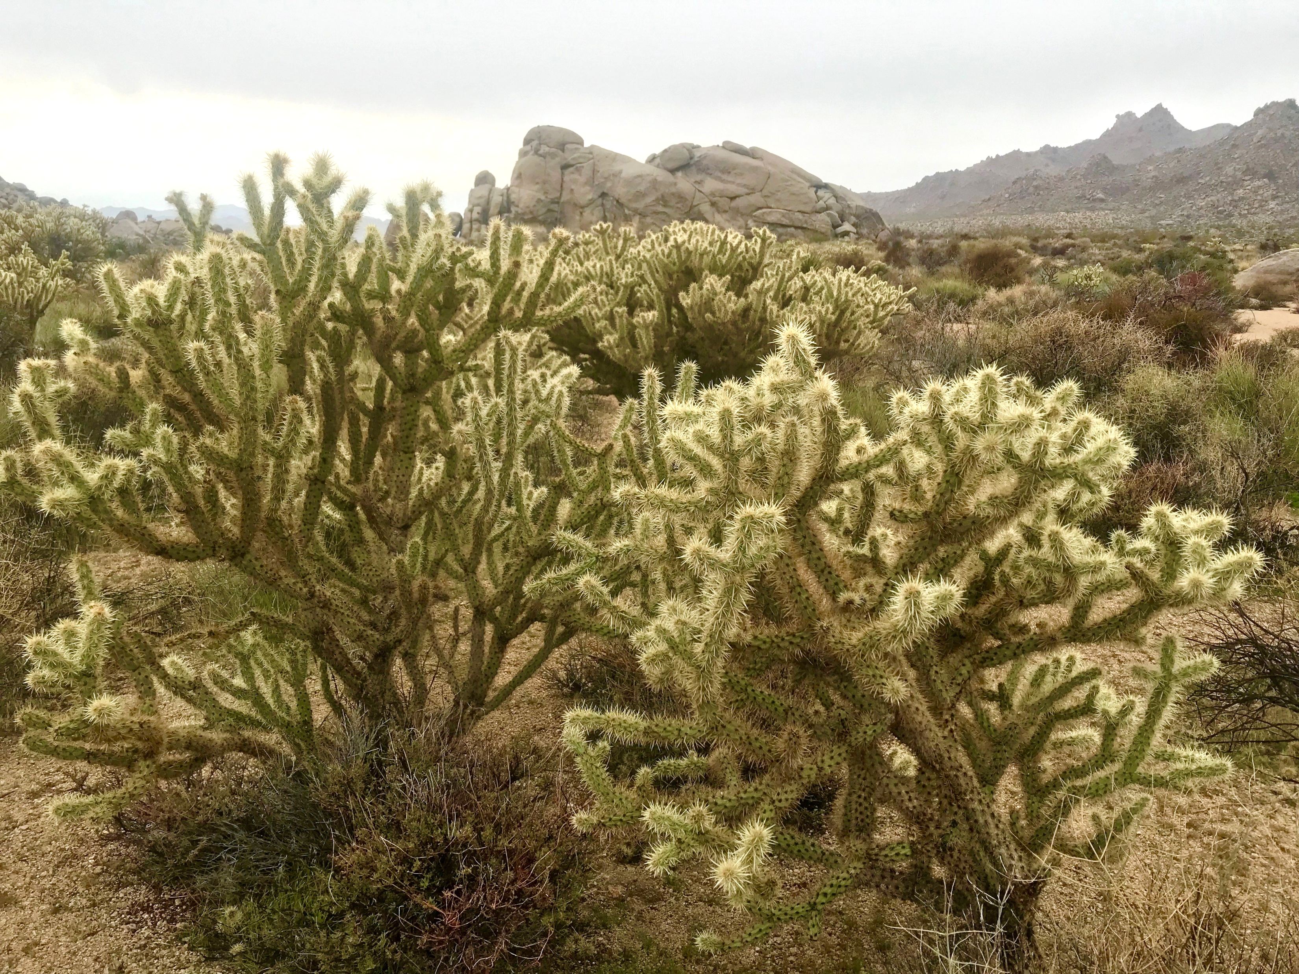
Discussion
Abundance, size, and health were “strongest” in C. acanthocarpa
Different niches
One study species > three study species
Likely foundational species
Notes:
For future surveys, we need abundance for replications in May and August, size to translate to birds, and health to encourage strong flowering.
Based on our morphological measurements, these cacti likely have little niche overlap in regards to nectarivorous and frugivorous birds.
This leads us to our next steps…

Slide 36
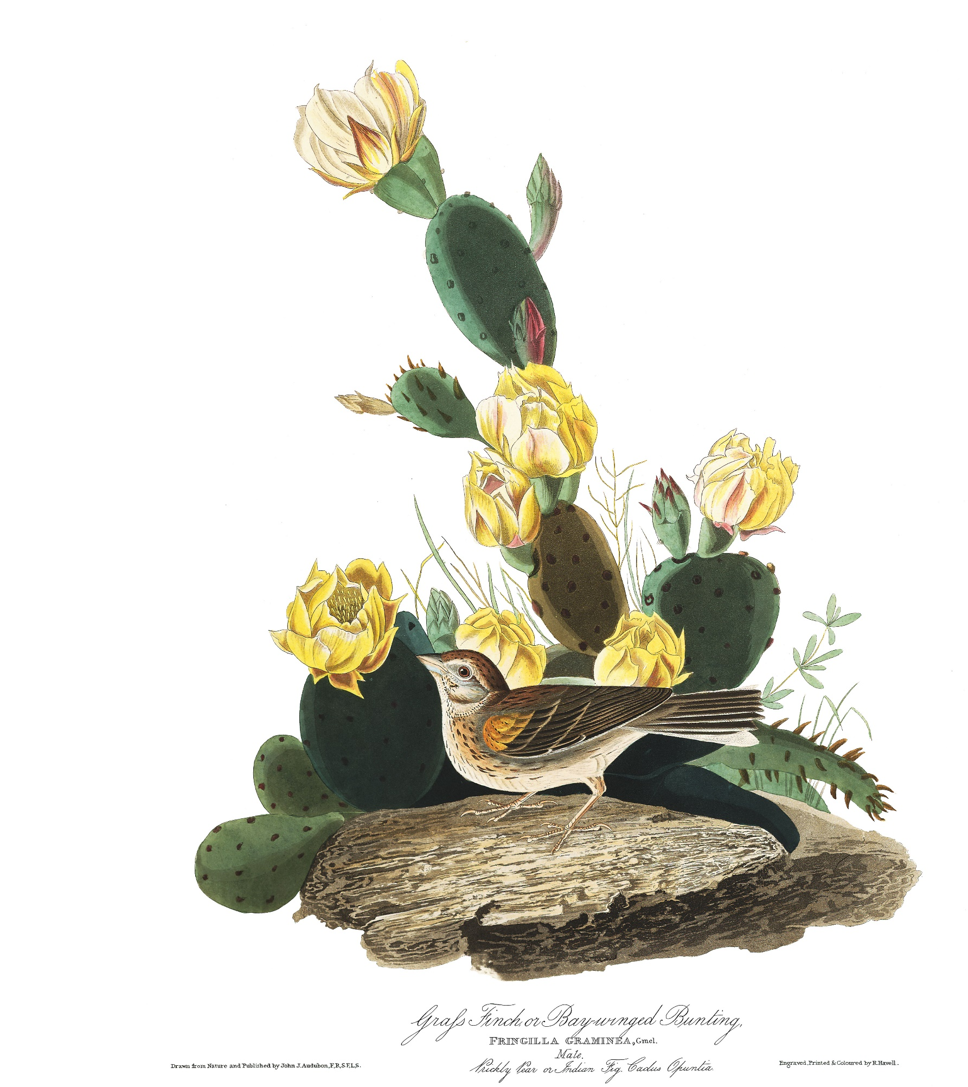
Looking forward
Reproductive output measurements
Interactors measurement
Mega-bloom arthropod pollinators
C. acanthocarpa facilitation experiments
Shrub/cactus mapping
Notes:
Mega bloom year because high rain means lots of cactus flowers, compare pollinators at C. acanthocarpa when cactus is blooming (parallel Jenna’s work on when annuals beneath canopy was blooming)
Follow up with pollinator facilitation experiments by Jenna two years ago during last mega bloom, but now during cactus blooming instead of annual blooming
Map all cacti and shrubs at Sunset cove (undergrad help)

Slide 37
If we understand:
Positive Interactions
Habitat Structure
Restoration/Protection of Deserts
Notes:
Implications
Deserts are diverse (not wastelands) in decline bc climate change, human development, and invasive species. All Cactaceae are listed on CITES Appendix II, with several ssp on Appendix I.
This project will help us understand how positive interactions influence habitat structure, and therefore combat habitat loss.
Restoration work has primarily focus on abiotic factors of habitat structure, but if we can identify biotic vectors of habitat creation and maintanence, this project potentially has the capacity to revamp the toolbox available to practioners.

Slide 38
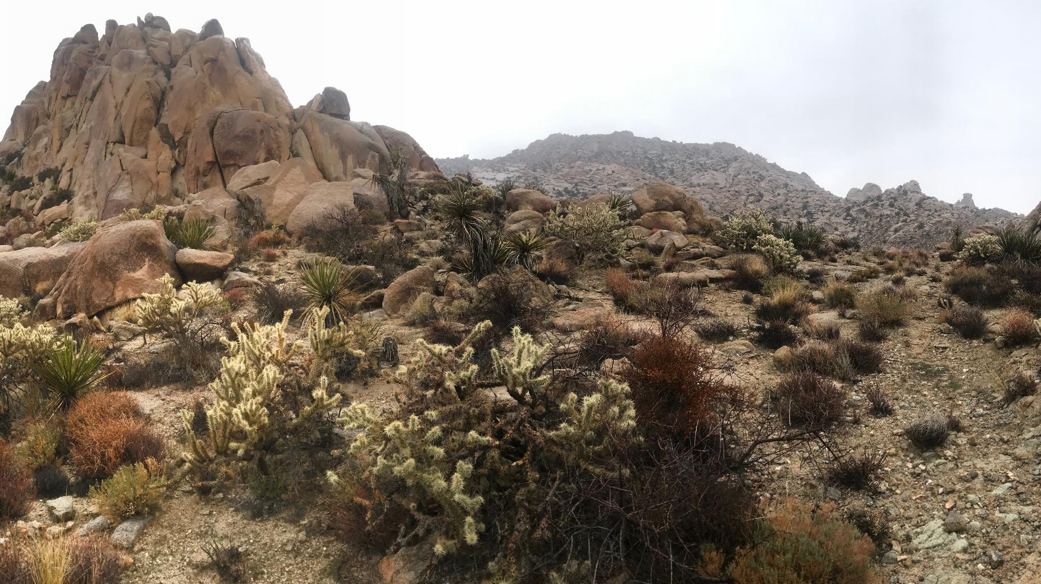
Thanks for listening!

